Slide 1
Online Exam Management System
Presented by:
Snehal Pawar

Slide 2
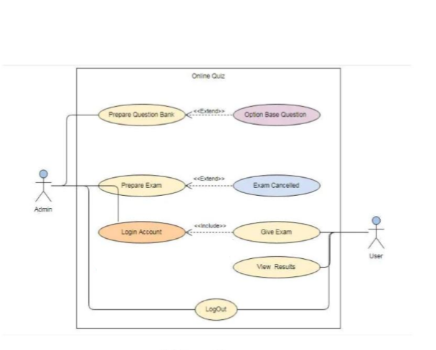
Diagram

Slide 3
Thank You!!!

